Slide 1
Searching & Sorting in a Banking Application (Initial Presentation)
Submitted by: Muhammad Talha (46287) & Hafiza Shujia Yousaf (47798)
Submitted to: Dr. Saman Riaz
Subject: Design and Analysis of Algorithms

Slide 2
Algorithms Used:
For Searching:
Two Pointers Technique
For Sorting:
TimSort
IntroSort

Slide 3
Timsort in a Banking Mobile Application
Overview:
Timsort is a hybrid sorting algorithm derived from merge sort and insertion sort. It works by dividing the data into runs and sorting these runs using insertion sort, then merging them using a process similar to merge sort. It is the default sorting algorithm in Python and Android’s Java.
Application in Mobile Banking
Transaction History: Displaying a user’s transaction history (sorted by date or amount).
Account Listings: Sorting a list of customer accounts by balance, account number, or name.
Loan Applications: Sorting loan applications based on interest rates, amounts, or approval status.

Slide 4
How Timsort Works
Identify Natural Runs: It scans through the data to find already sorted sub-sequences (runs). For example, transactions might already be sorted by date in parts.
Sort Small Runs: Uses insertion sort on small runs for better performance.
Merge Runs: Uses a merging technique similar to merge sort for larger data.

Slide 5
Why Timsort is Suitable
Real-World Data: Most real-world banking data has partially sorted patterns (natural runs).
Adaptive: Timsort adapts to the size and pattern of data, making it efficient for large datasets.
Stable Sorting: Ensures that equal elements maintain their relative order, which is useful for sorting objects with multiple attributes (like transactions).

Slide 6
Introsort in a Banking Mobile Application
Overview
Introsort (Introspective Sort) combines quicksort, heapsort, and insertion sort. It starts with quicksort and switches to heapsort if the recursion depth exceeds a certain limit to avoid worst-case performance.
Application in Mobile Banking
Sorting Customers: When fetching and displaying customers based on balance or name.
Card Transactions: Sorting credit or debit card transactions based on the transaction date or amount.
Interest Rates: Sorting loan interest rates or deposit schemes.

Slide 7
How Introsort Works
Initial Phase with Quicksort: Uses quicksort for partitioning data.
Switch to Heapsort: If the recursion depth grows too large (a sign of potential worst-case behavior), it switches to heapsort.
Insertion Sort for Small Partitions: Handles small partitions with insertion sort for efficiency.

Slide 8
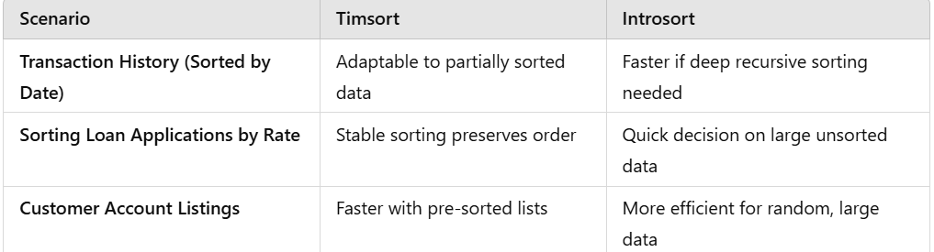
Why Introsort is Suitable
Versatile: Provides optimal performance across various input sizes.
Predictable Time Complexity: Avoids quicksort’s worst-case behavior with heapsort.
Efficient for Large Data: Banking applications may handle large data like bulk customer records, making introsort’s efficiency crucial.

Slide 9
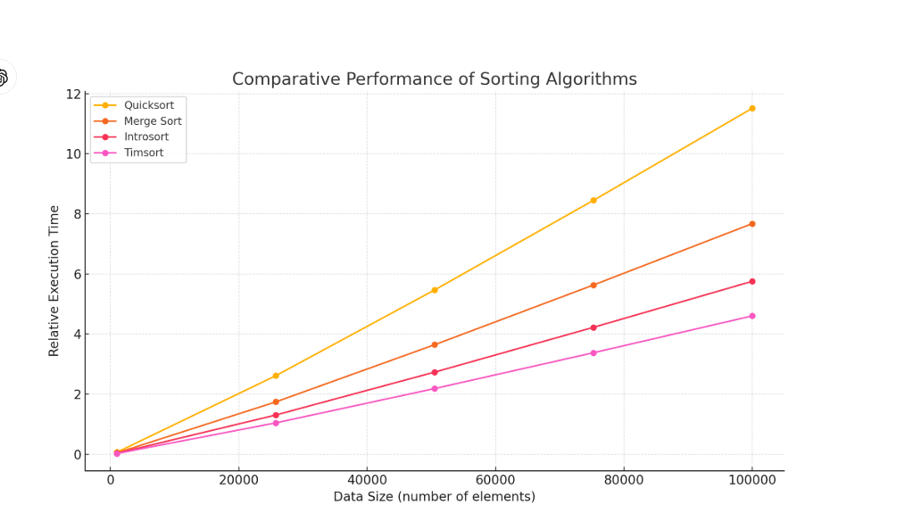

Slide 10
Two Pointers Technique
Overview
This technique uses two pointers that traverse the data structure simultaneously, often from opposite ends or moving at different speeds. It is useful for:
Searching pairs or finding subsequences with certain properties.
Eliminating redundant loops to improve time complexity.

Slide 11
Applications in Banking Mobile Application
Searching for Transactions within a Range
Time Complexity: O(n), much faster than a nested loop (O(n²)).
Detecting Duplicate Transactions
By sorting the transactions first, a single pass with two pointers can identify duplicates in O(n log n + n) time.
Merging Sorted Lists
Combining debit and credit transaction histories sorted by date using two pointers.
One pointer iterates over the debit transactions, and another over the credit transactions. The smaller date between the two moves forward in a merge-like process.

Slide 12
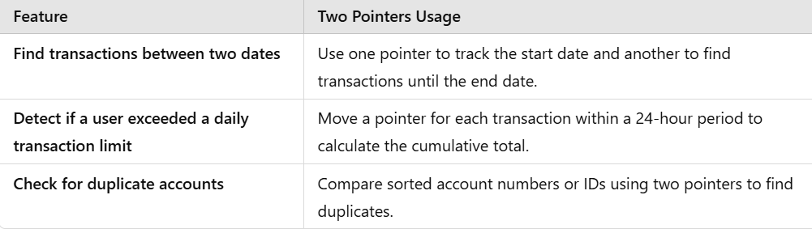
Advantages of Two Pointers Technique
Efficiency: Reduces time complexity from O(n²) to O(n) or O(n log n).
Simple Implementation: Easier to implement than advanced search structures for sorted data.
Simple Implementation: Easier to implement than advanced search structures for sorted data.

Slide 13
